Slide 2
SM1-2

Slide 3
Information Essay

Slide 4
Which technology helps to study?
By. 황준화

Slide 5
Which technology helps to study?
By. 황준화

Slide 6

Now
By. 황준화

Slide 7

The technologies are developing
By. 황준화

Slide 8
The technologies are developing
By. 황준화

Slide 9



and appear anything.
By. 황준화

Slide 10


So, we don’t have to study with pen or paper.
By. 황준화

Slide 11

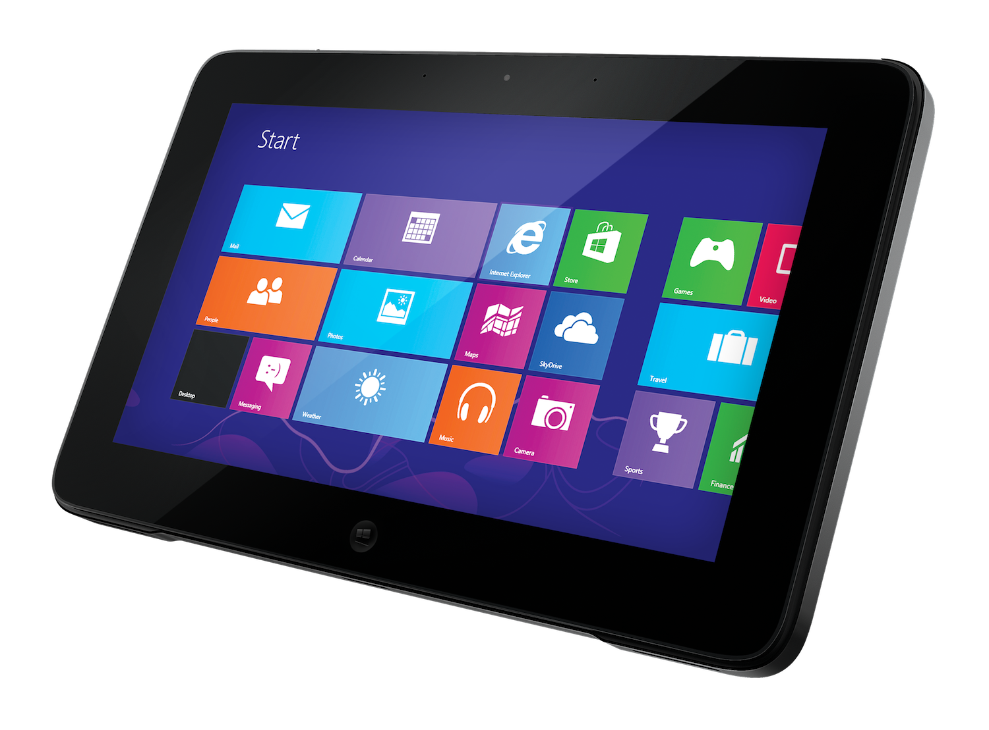

We can use Tablet, Zoom and online Wiki
By. 황준화
알 수 없는 작성자 님의 이 사진에는 CC BY-SA 라이선스가 적용됩니다.

Slide 12
Tablet is a computer with touchscreen like IPad
By. 황준화
알 수 없는 작성자 님의 이 사진에는 CC BY-SA 라이선스가 적용됩니다.

Slide 13
Zoom is online meeting program: became famous for COVID-19
By. 황준화
알 수 없는 작성자 님의 이 사진에는 CC BY-SA 라이선스가 적용됩니다.

Slide 14

Online Wiki is a website to edit document like wikipedia
By. 황준화
알 수 없는 작성자 님의 이 사진에는 CC BY-SA 라이선스가 적용됩니다.

Slide 15
I think tablet is most useful. So I will explain “Why”
By. 황준화
알 수 없는 작성자 님의 이 사진에는 CC BY-SA 라이선스가 적용됩니다.

Slide 16

The first reason. Tablet’s performance

Slide 17

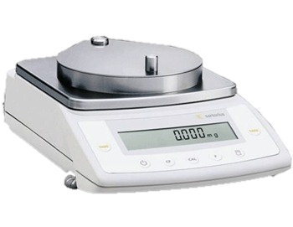

Tablet is a small computer with a touch screen without a keyboard or mouse.
So, we can search information like computer. And we can
Move it easily like phone.
Also, tablet wights no more than 900 grams.
900g
The first reason. Tablet’s performance

Slide 18

The second reason. Program

Slide 19


Tablet can run programs such as Zoom. Because tablet normally have OS like IOS, Linux. It uses kernel and shell to run program. For that reason more useful than Zoom.
The second reason. Program

Slide 20

The third reason. Browser & conclusion

Slide 21



The browser, changes HTML, picture, multimedia file etc, and WWW so we can see.
To sum up, the tablet is light and have a lot of information finally can run program and browser.
So tablet is most useful to study
The third reason. Browser & conclusion

Slide 22
The browser, changes HTML, picture, multimedia file etc, and WWW so we can see.
To sum up, the tablet is light and have a lot of information finally can run program and browser.
So tablet is most useful to study
Thank you for watching

